Slide 1
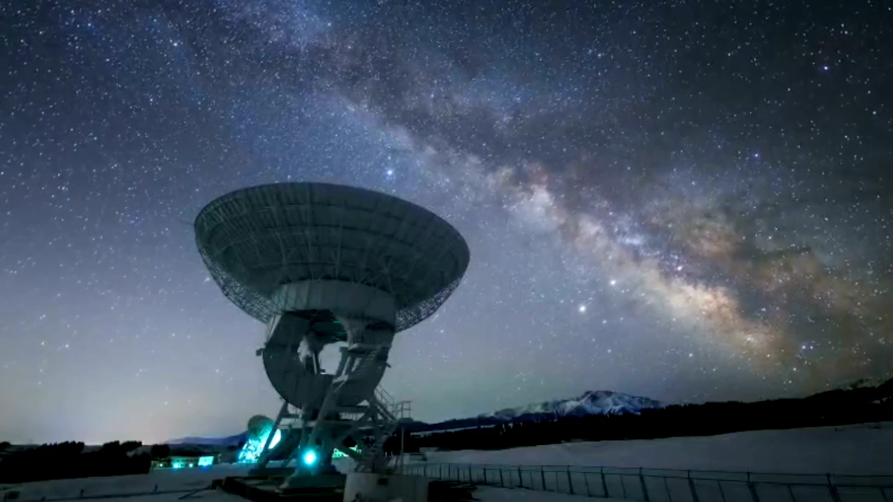
Photometric Analysis of the Night Sky
Muhammad Ahmad Mirza

Slide 2
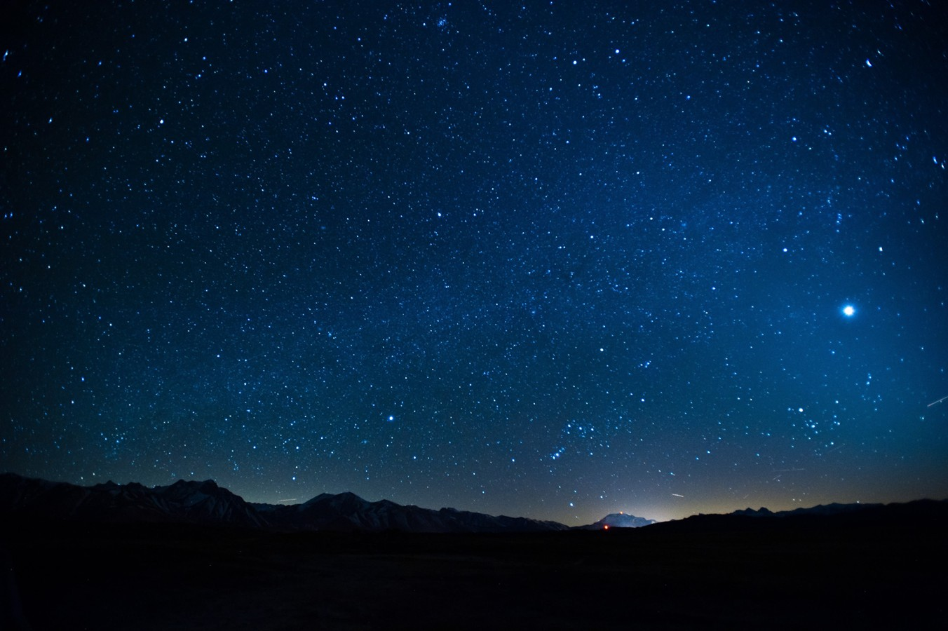
What is Photometry
Definition:
Photometry is the measurement of the brightness (or flux) of astronomical objects, typically in one or more wavelength bands, over time.
The two types are:
Absolute photometry: Measuring the actual flux in physical units.
Relative photometry: Measuring the brightness of a target star relative to one or more comparison stars. This is what you're doing

Slide 3
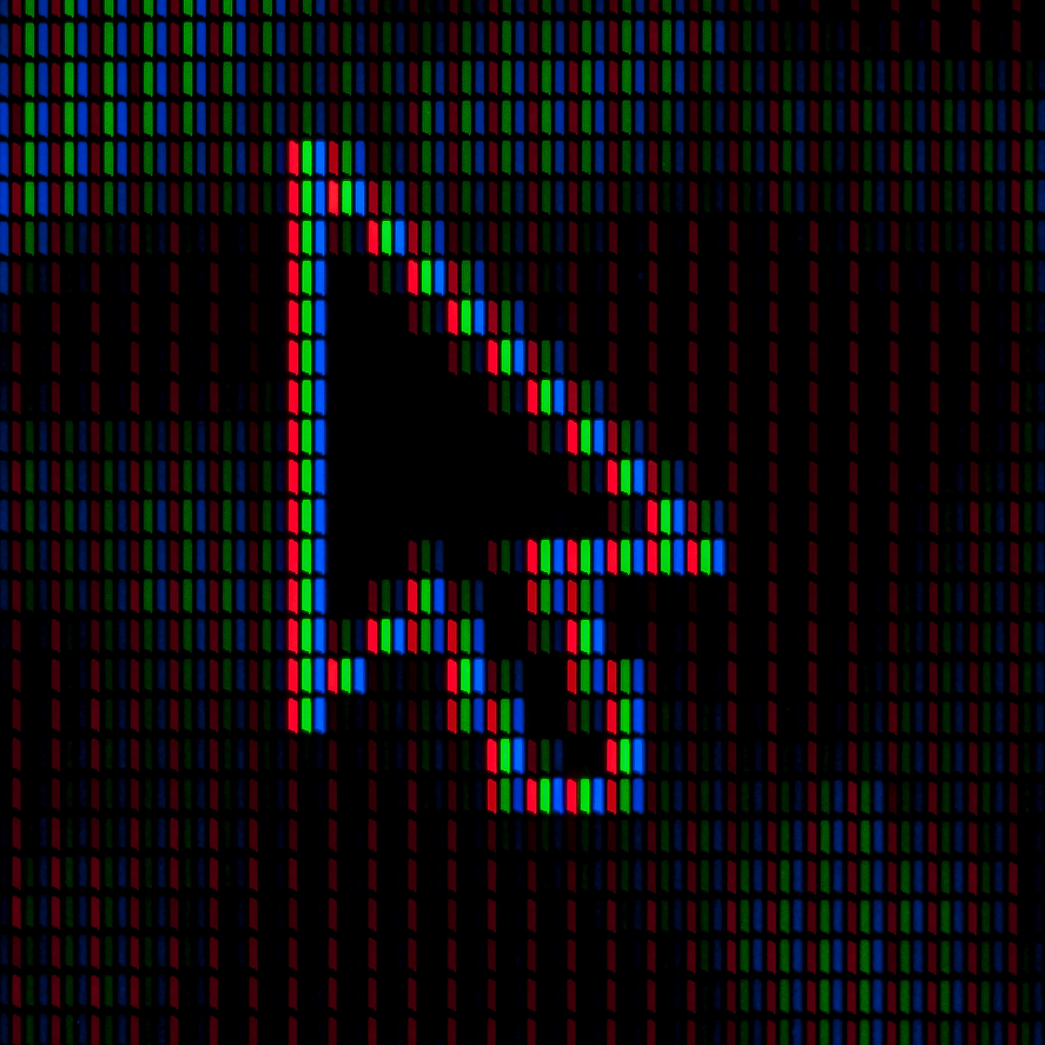
Image Calibration
Flat Field Correction __________ Fixes uneven lighting and dust by normalizing pixel response.
Dark Frame Subtraction _______ Removes thermal noise from long exposures.
Bias Correction ______________ Eliminates electronic readout noise from the sensor.
Image Stacking ______________ Combines images to boost signal and reduce random noise.
Sky Background Subtraction ___ Clears sky glow or light pollution for clean star data.

Slide 4
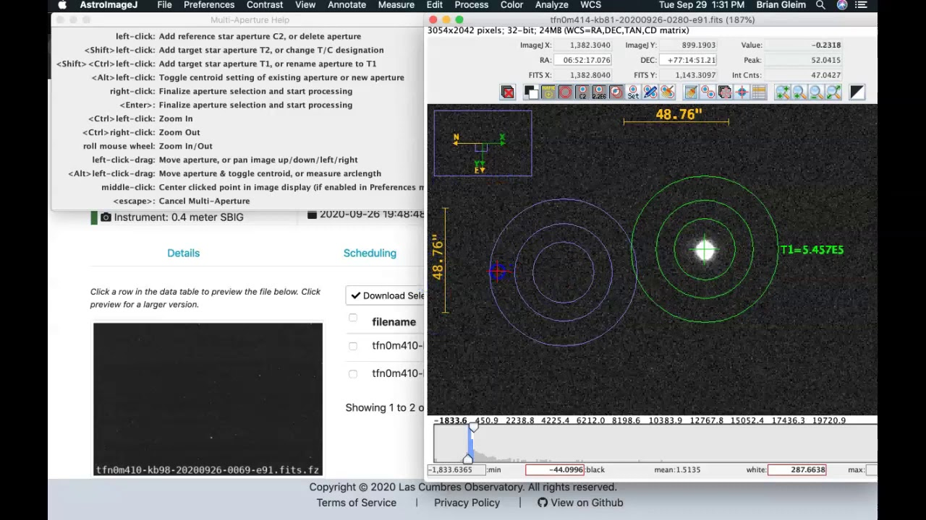
Aperture Photometry with Image Alignment
AstroImageJ
Image Alignment:
aligns all images using astrometric registration or cross-correlation to correct for small telescope tracking shifts, jitter, or atmospheric drift
Uses reference stars or WCS
translation, rotation, and scaling
Multi-Aperture Photometry
For each aligned frame, AIJ places identical circular apertures at the same sky position across all frames.
For each aperture:
Sum pixel values inside the source radius
Subtract the median background from a surrounding sky annulus

Slide 5
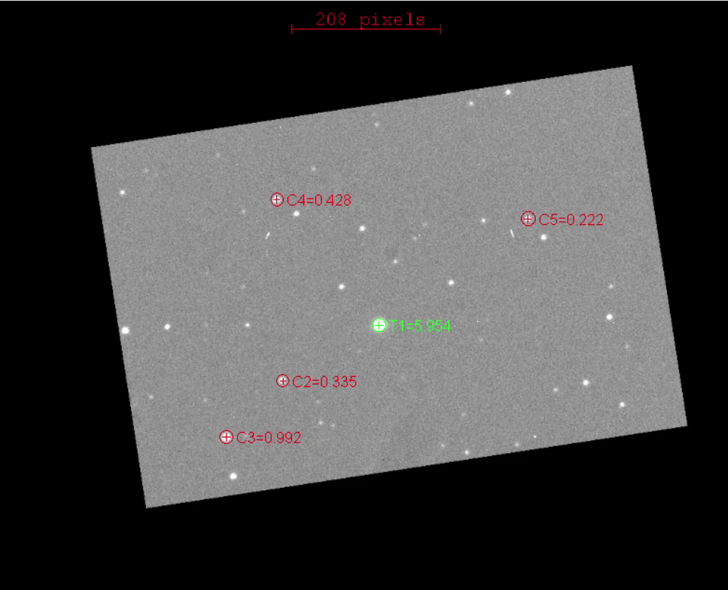
Image stacking
Improves Signal-to-Noise Ratio (SNR)

Slide 6
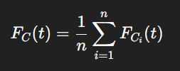
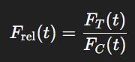
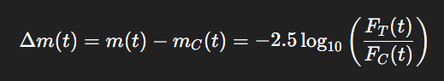
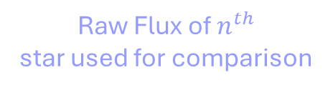
Differential Photometry
Raw Flux of $n^{th}$
star used for comparison
Differential Flux of the same star
Flux of the target star
Conversion to magnitudes

Slide 7
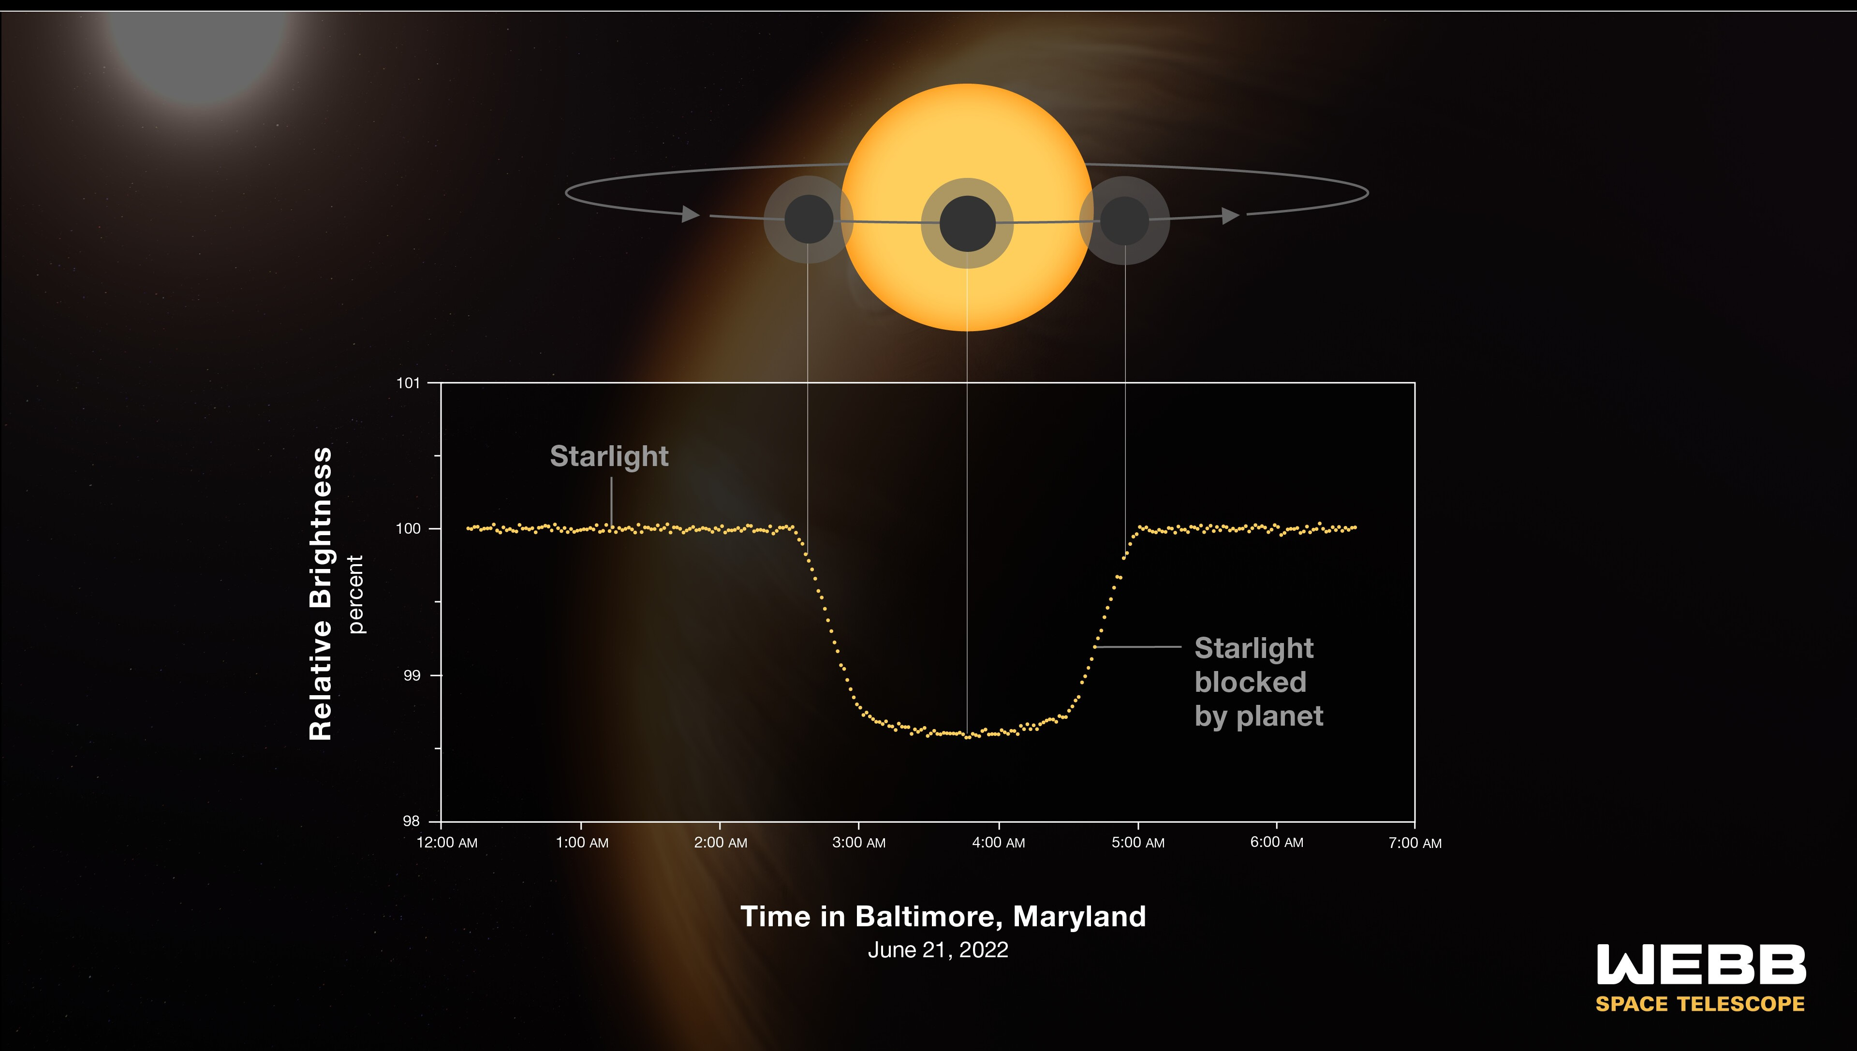
Light Curves

Slide 8
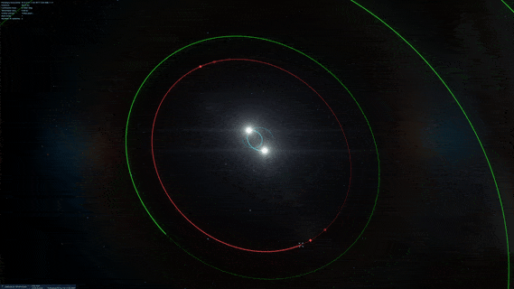

Slide 9
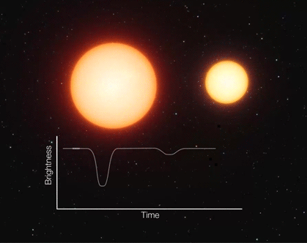
Detached binary Systems

Slide 10
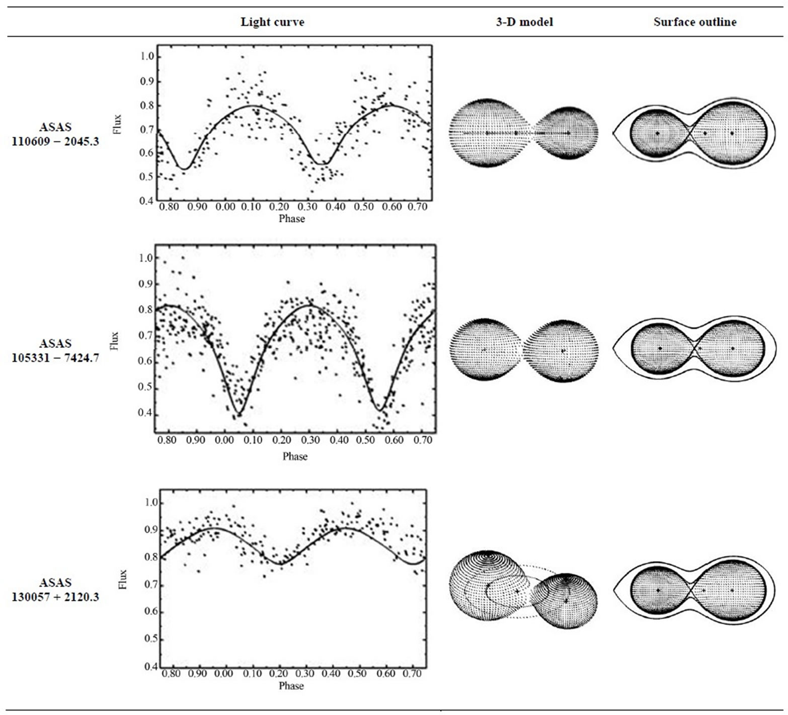
Contact Binary System
The two stars are so close that their outer atmospheres are in contact, sharing a common envelope

Slide 11
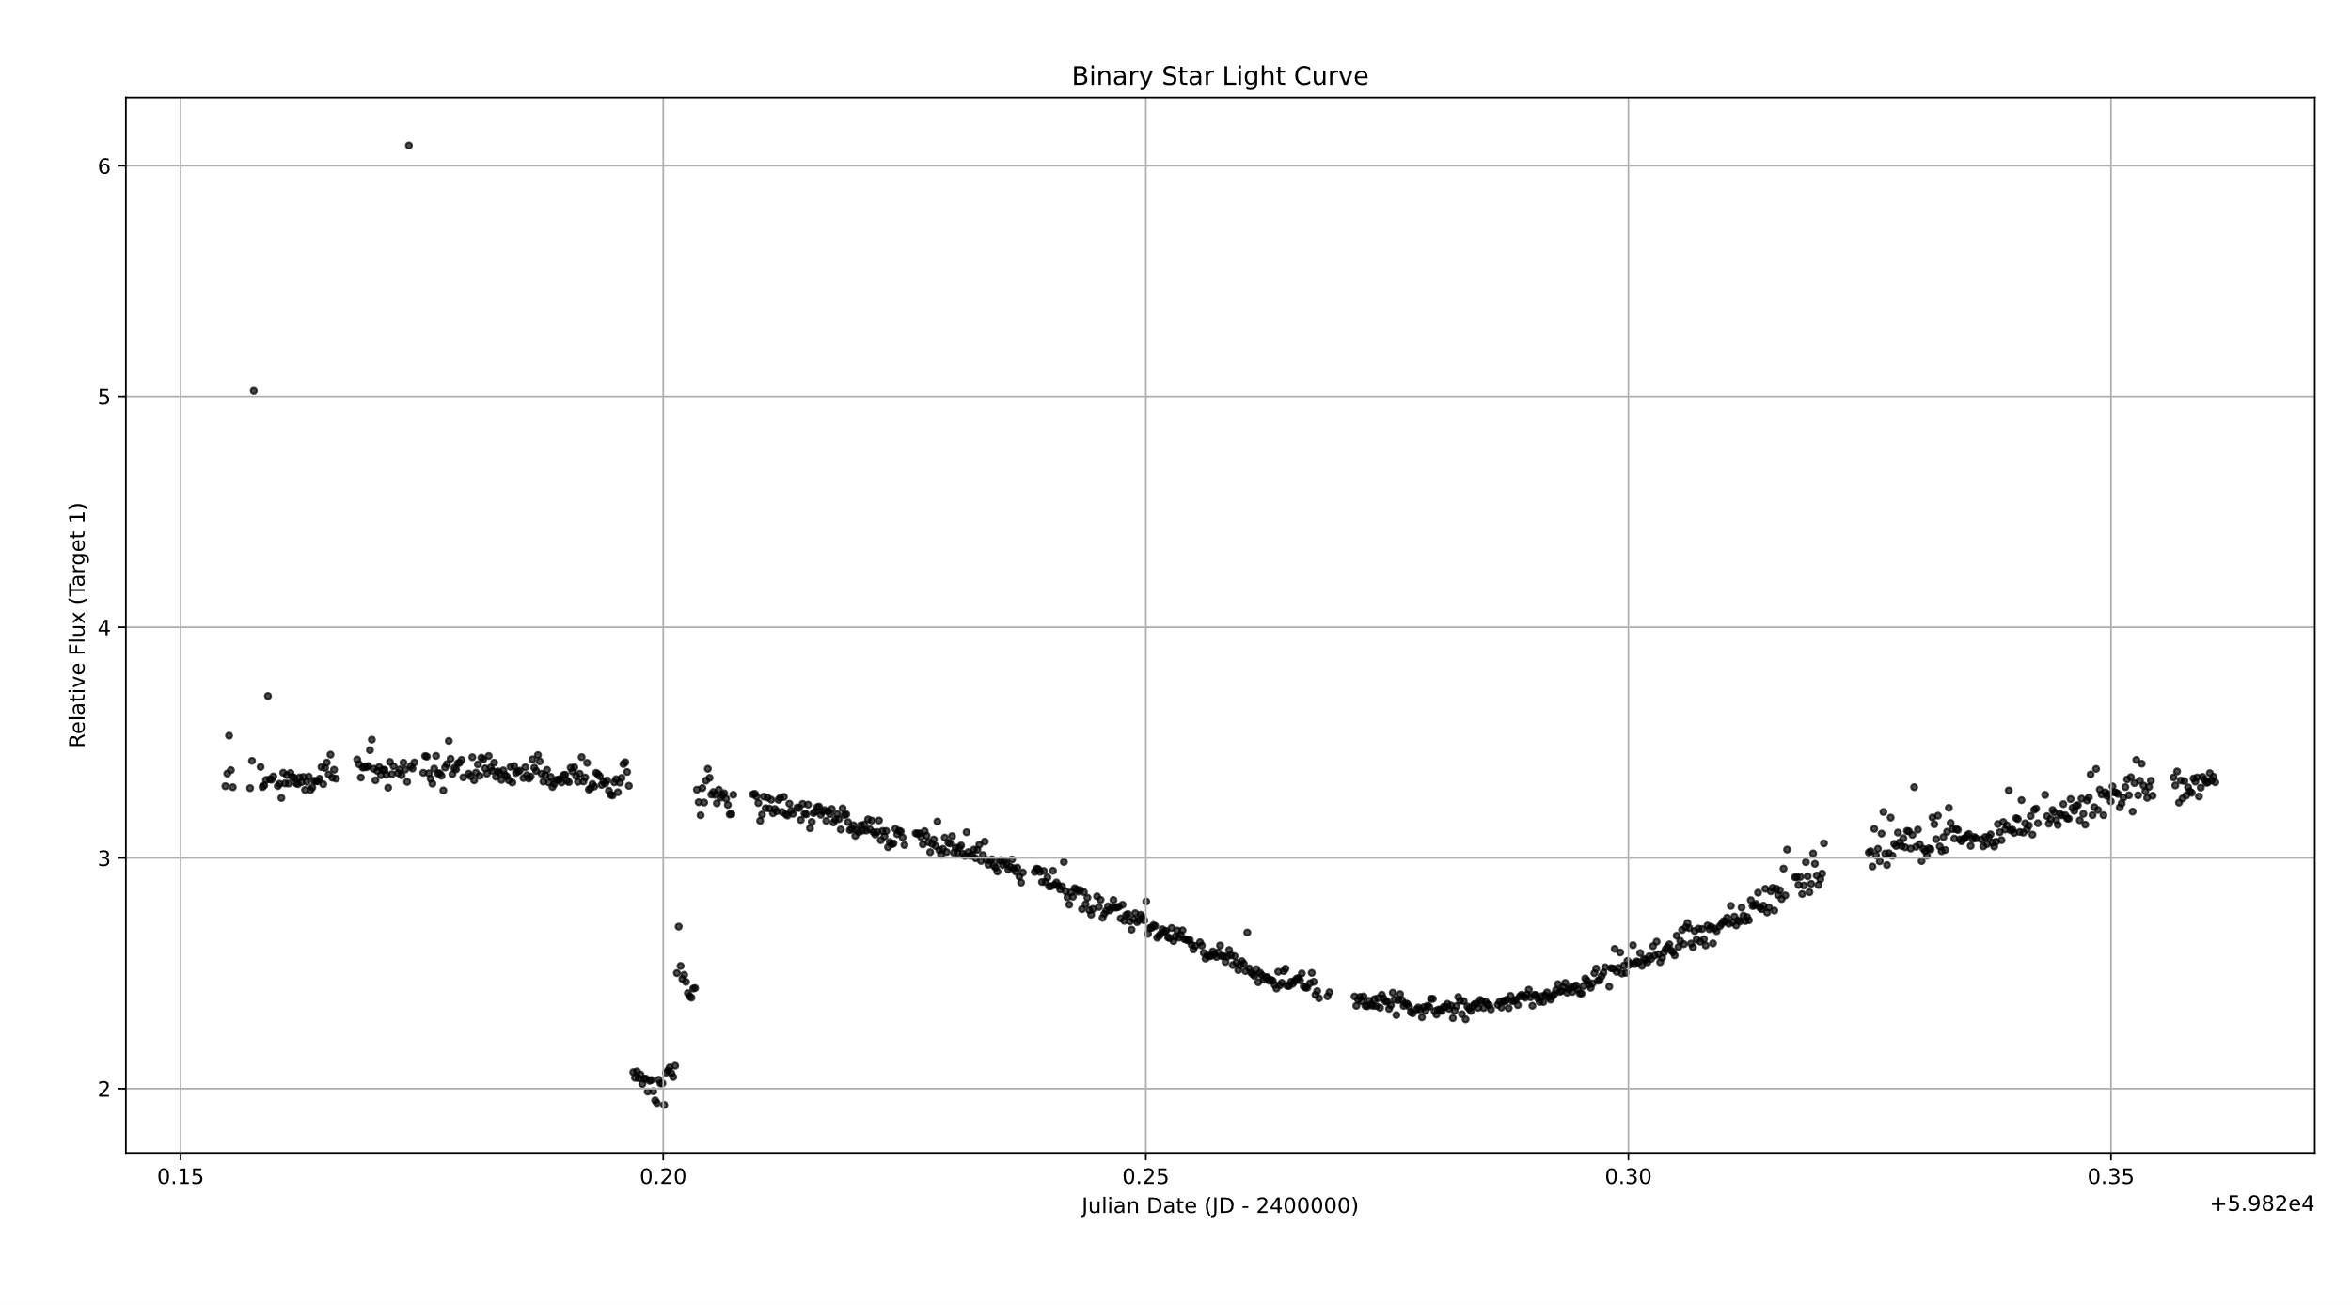
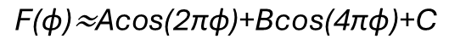
Our Light Curve
$$\text{F}\text{(}\text{ϕ}\text{)≈}\text{Acos}\text{(2}\text{πϕ}\text{)+}\text{Bcos}\text{(4}\text{πϕ}\text{)+}\text{C}$$

Slide 12
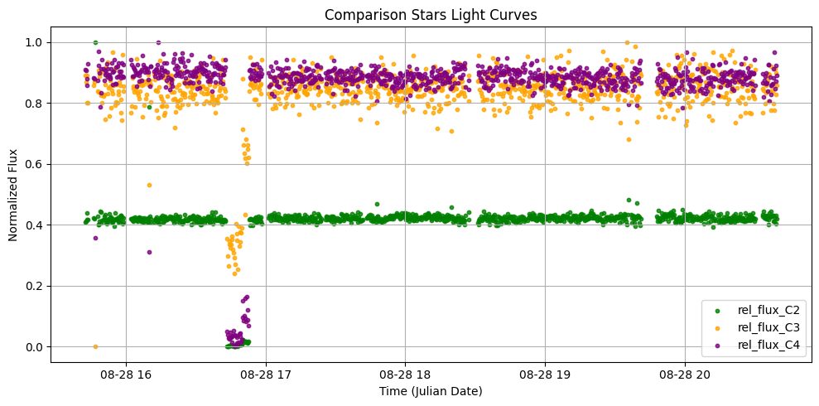
Ensuring Consistency

Slide 13
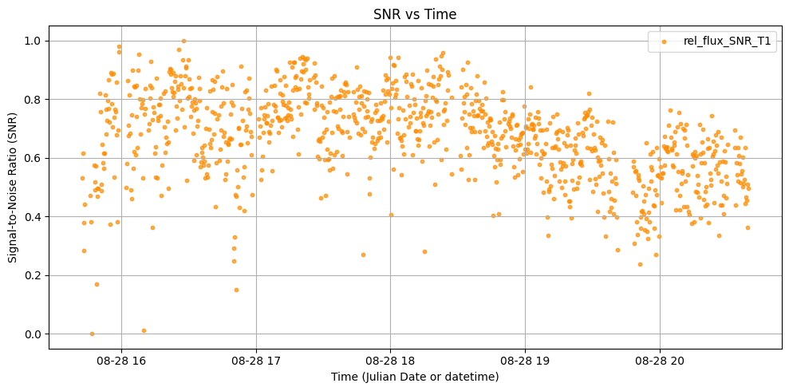
Noise
SNR (Signal-to-Noise Ratio) measures the quality of photometric data at each time point.
Random noise appears as unstructured fluctuations with no clear pattern.
Systematic noise shows trends or repeated variations due to instrumental or atmospheric effects.
Identifying the noise type helps assess the reliability of the light curve and correct for errors.
Noise is any unwanted or unpredictable variation in data that obscures or distorts the true signal being measured. i.e Weather, Radiation, Dust, Rural Lights etc.

Slide 14
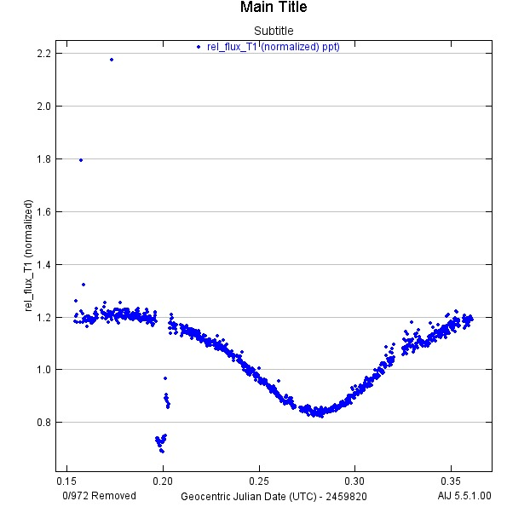
Presenting Findings
Graphically Estimating
The orbital period / Transit Time:
0.35-0.15 = 0.2 days
0.2 days = 5 hours
Since we have half of the sine curve
5 hours*2 = 10 hr
10 Hours Full transit period
Similarly, we can do this using a program

Slide 15
The End

